Slide 1
Mobile Banking
BTPN Syariah
Doni Wahyudi – BTPNS Shifted Batch 2

Slide 2
Latar Belakang
Volume transaksi kartu debit per April 2020 menurun 66 juta kali transaksi dari 561,3 juta transaksi dikarenakan penerapan PSBB dan ketakutan akan penularan virus corona lewat mesin ATM
Mobile banking BTPN Syariah menjadi solusi yang tepat dalam memperluas jangkauan serta kebermanfaatan Bank BTPN Syariah, selaras dengan Blueprint Sistem Pembayaran Indonesia (BSPI) 2025 yang disusun oleh Bank Indonesia.
Source: Bank Indonesia
13,2%
Transaksi kartu debet menurun
Mobile Banking BTPN Syariah
73,7%
Pengguna Intenet meningkat
Jumlah pengguna internet di Indonesia Q2 tahun 2020 mencapai 196,7 juta jiwa
Source: survei Asosiasi Penyelenggara Jasa Internet Indonesia (APJII)
Pengguna Smartphone
naik selama WFH
Transaksi uang elektronik meningkat
24,7%
70,1%
Transaksi uang elektronik meningkat dari 330,4 juta kali menjadi 412,1 juta kali per April 2020
Pengguna Smartphone naik dari 168,9 juta jiwa (2019) menjadi 187,1 juta jiwa (2020), tumbuh 6.8%
Source: Asosiasi Fintech Indonesia
Source: databoks.katadata.co.id

Slide 3
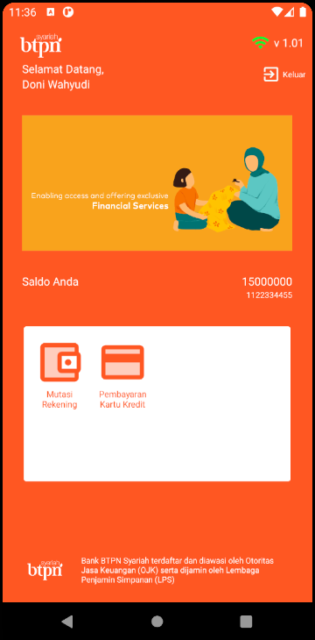
Next: Detailed Features
Application Main Features
Register Nasabah Baru
Login dan Logout Nasabah
Mutasi Rekening
dan cek Saldo
Pembayaran Kartu Kredit

Slide 4
Application Features
More Detailed Features
Password mask and unmask
in Login Page
1
Show Nasabah’s Fullname, Saldo, and Account Number
in Home Page
2
Image Slider Carousel for Bank Promotion Info
In Home Page
3
Horizontal Mutasi List Scroll View for better display
In Mutasi Page
4

Slide 5





Technology Behind the App
RabbitMQ
For queuing message between consumer and producer
Springboot
Android Studio
Java Framework used for making API Structure
Integrated Development Environment (IDE) for build android app
Java
MySQL
Programming Language used for main app and mobile app
Database Management System

Slide 6


Architecture System
Dummy Credit Bank Server
Front Producer
Back Consumer
Database Server
Back Producer
Rest API Controller
Front Consumer
MySQL

Slide 7


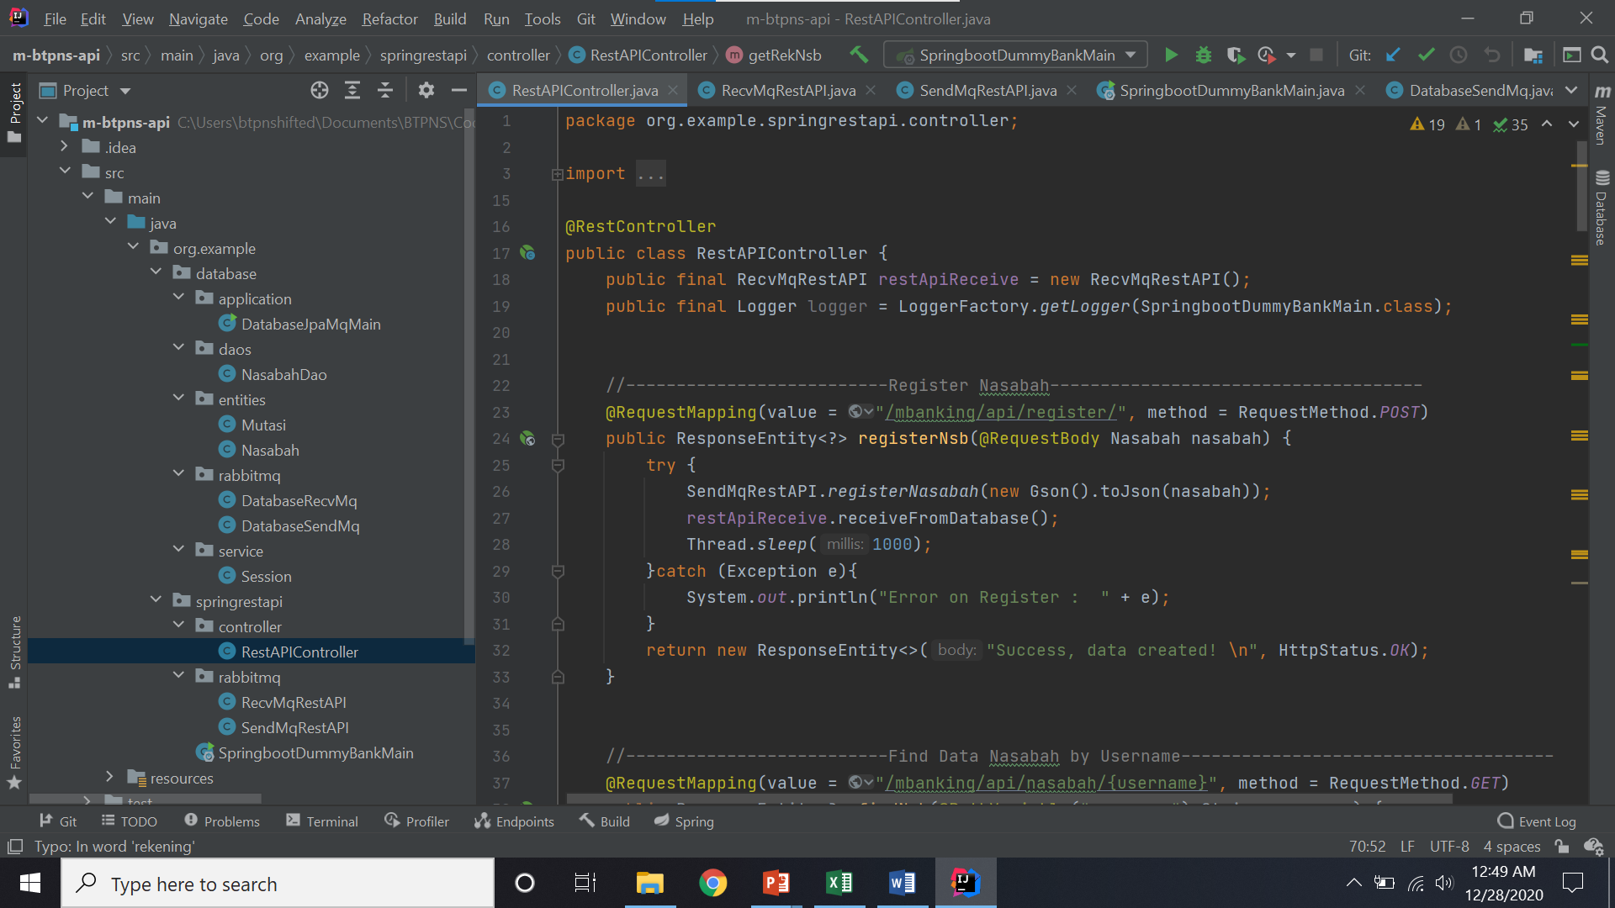
Rest API Mapping
How Social Media Influences Purchase Decisions

Slide 8

Application Security
Login
Authentication
Prepared Statement
Get data from API
Server Query
Prevent data leakage by authenticating user session in server
Prevent SQL Injection by using prepared statement
Password
Masking
Confirmation Dialogue Box
Login Page
Payment Transaction
Protect from people around peeping user’s password
Pop up dialogue box to prevent user carelessness

Slide 9
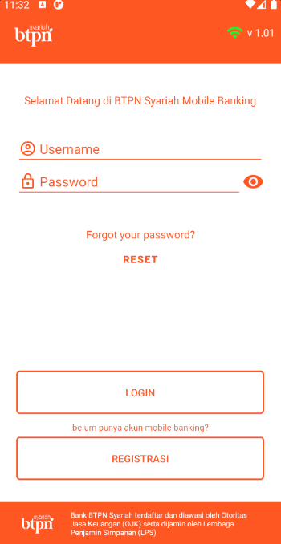
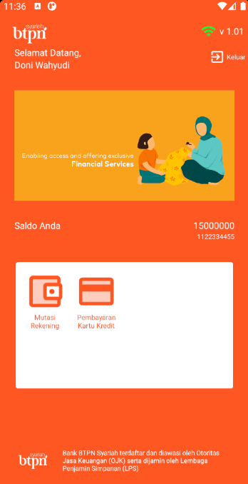
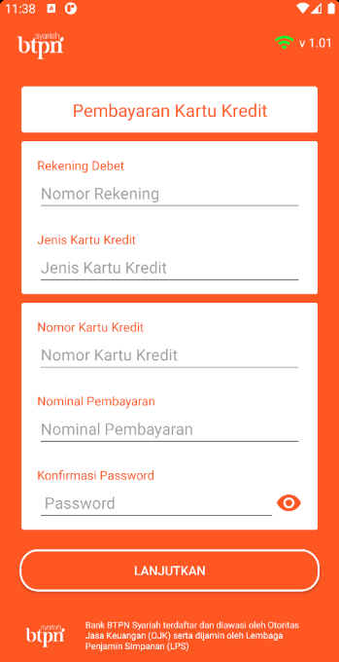
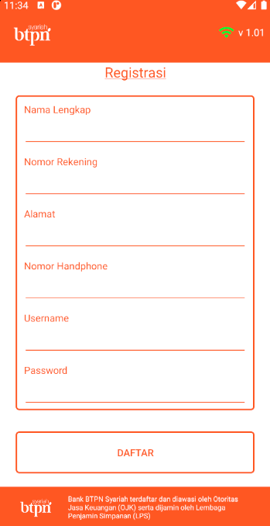
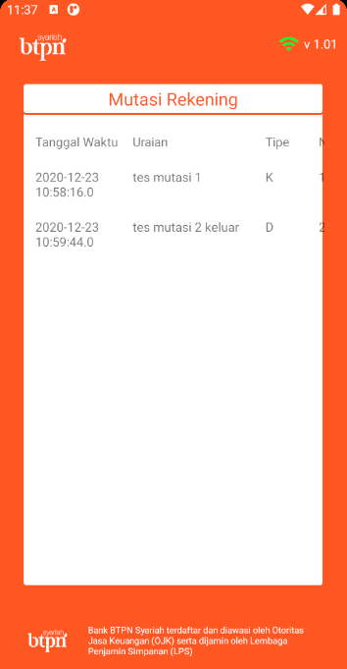
Application Layout
Register Page
Mutasi Page
Login Page
Home Page
Credit Payment Page

Slide 10

Thank You

Slide 11
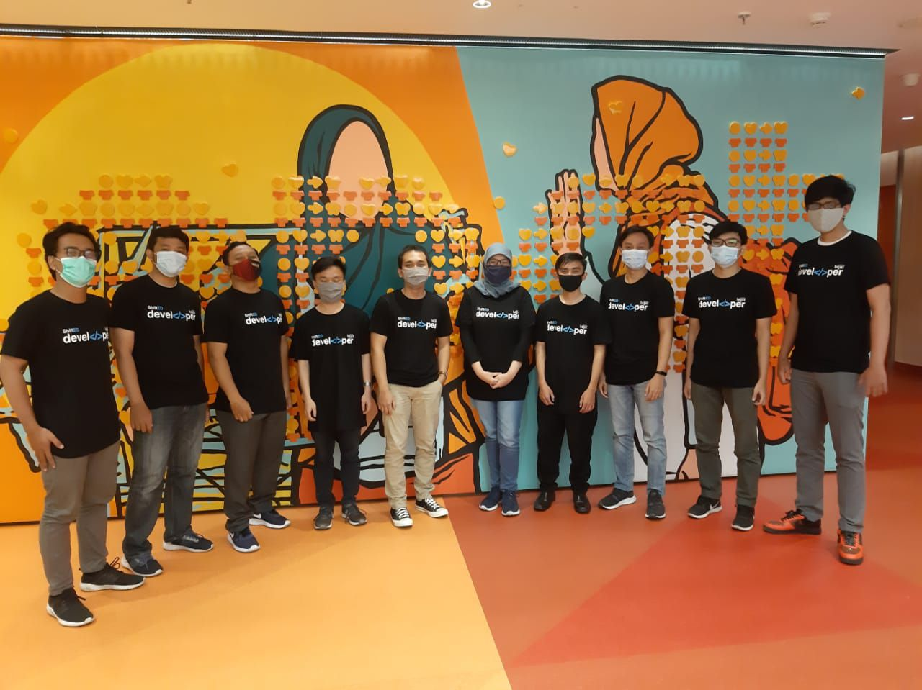
Thank You

